Slide 1

June 17th, 2024
Advanced Sampling Strategies
RAVEN Workshop

Slide 2
Objectives
Understanding Advanced Sampling Strategies in RAVEN
Latin Hypercube Sampling
Stochastic Collocation for Generalized Polynomial Chaos
Contrasting Sampling Strategies

Slide 3
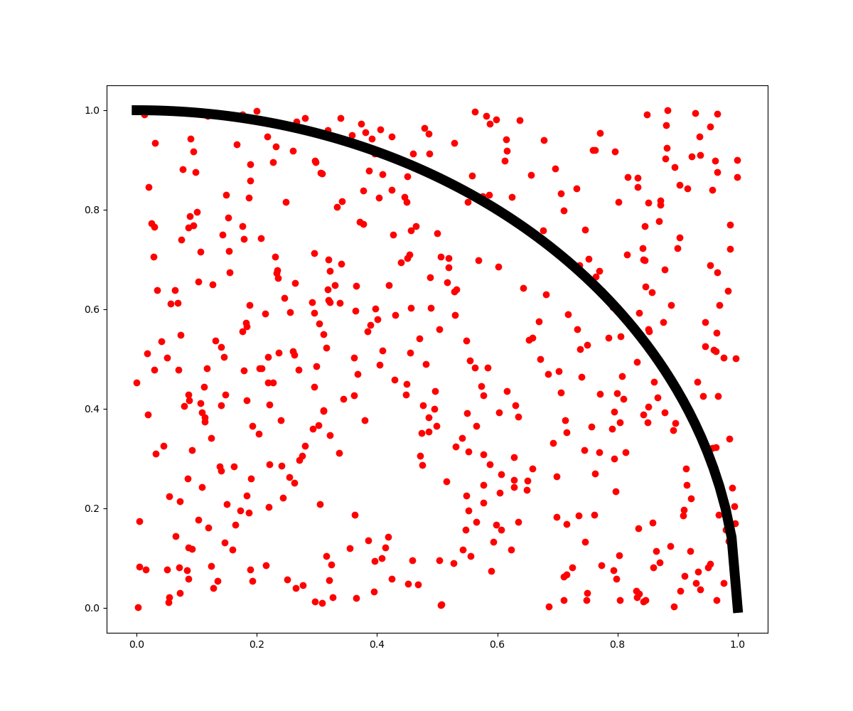
Monte Carlo, Grid, and Latin Hypercube
Bread and Butter Sampling

Slide 4

Simple Sampling: Monte Carlo
Law of Large Numbers
Frequently used to investigate complex problems
Calculate statistics (mean, stdv, etc)
Generate training data for MLAI
Comparison to experiments
“Given a sample of independent and identically distributed values, the sample mean converges to the true mean.”

Slide 5
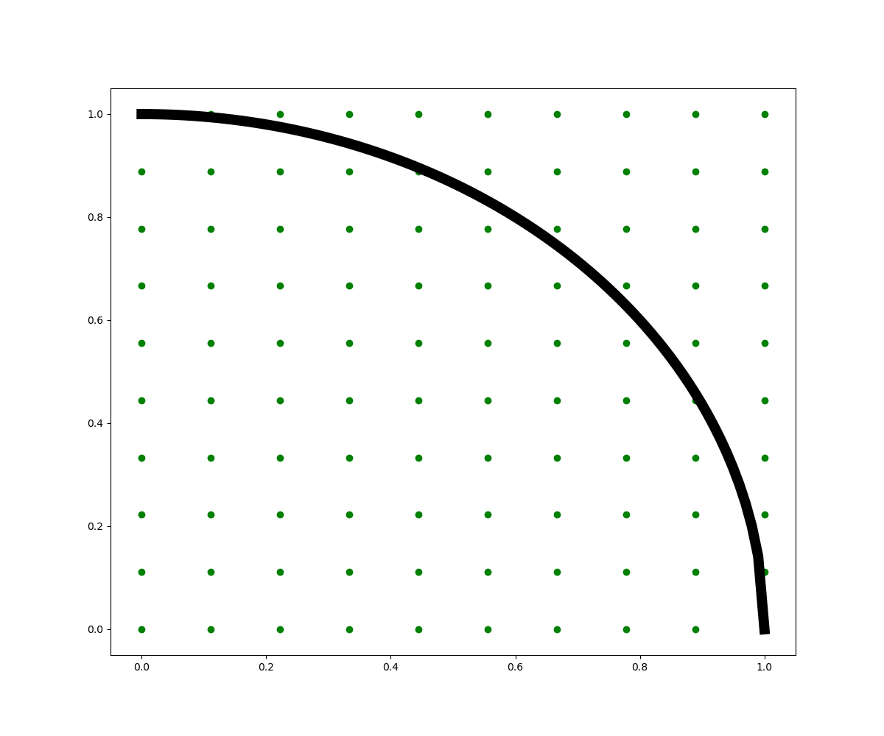
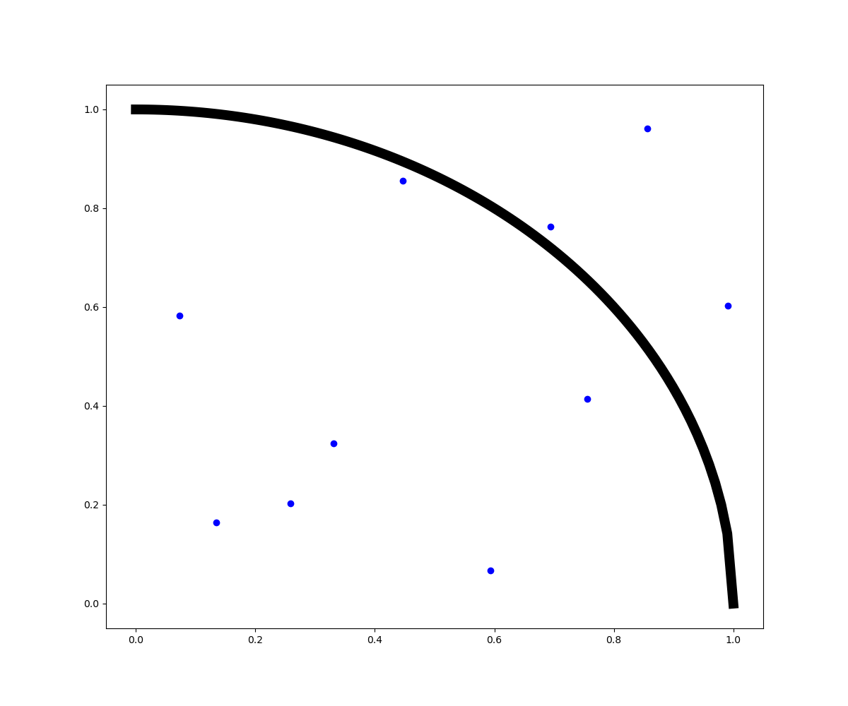
Other Sampling Strategies
Grid Sampling
Equally distributed samples
Curse of dimensionality (!)
Latin Hypercube Sampling (LHS)
Still placed into a grid
One sample per row, column
Dimension Invariant

Slide 6
Comparing MC, Grid, and LHS Exercise
Code: projectile.py
Activity: Compare statistics
mean, variance
range, time of flight
Vary:
Initial velocity
Initial angle
Try:
Vary number of MC, LHS samples
Compare statistics
Advanced:
Sample additional variables
Exercise:
Currently set up to run MonteCarlo
What to Change for Grid, LHS
RunInfo.WorkingDir
Steps.MultiRun.Sampler
Type
Name
Optional
Save input files as grid.xml, lhs.xml
raven/doc/workshop/advancedSampling/
inputs/mc.xml

Slide 7
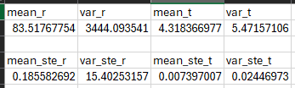
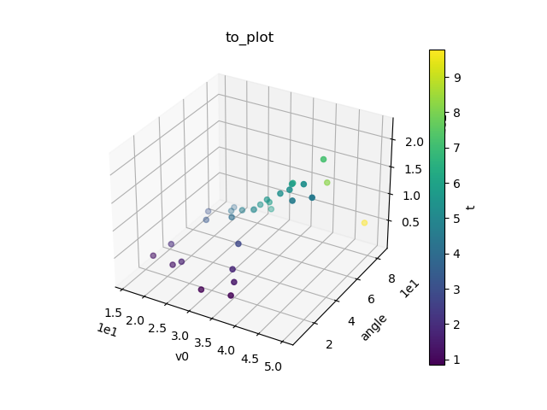
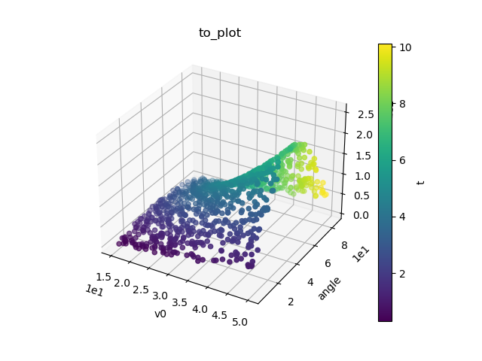

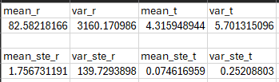
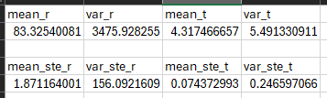
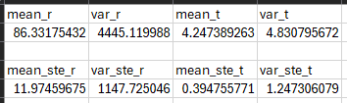
MC, Grid, LHS
MC 1e5 Samples:
MC
Samples: 1024
Grid
Samples: 1024 (32x32)
LHS
Samples: 32

Slide 8
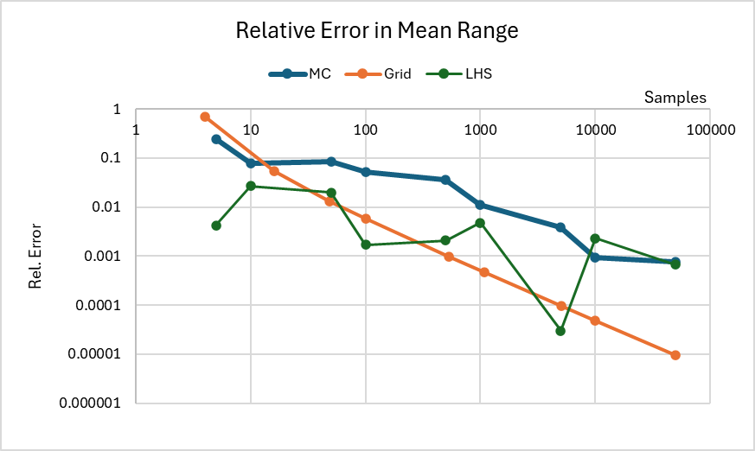
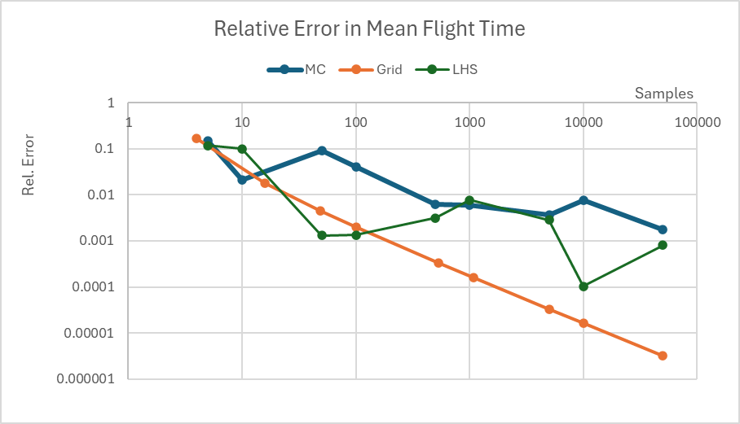
Sampler Convergence Plot (MC, Grid, LHS)

Slide 9
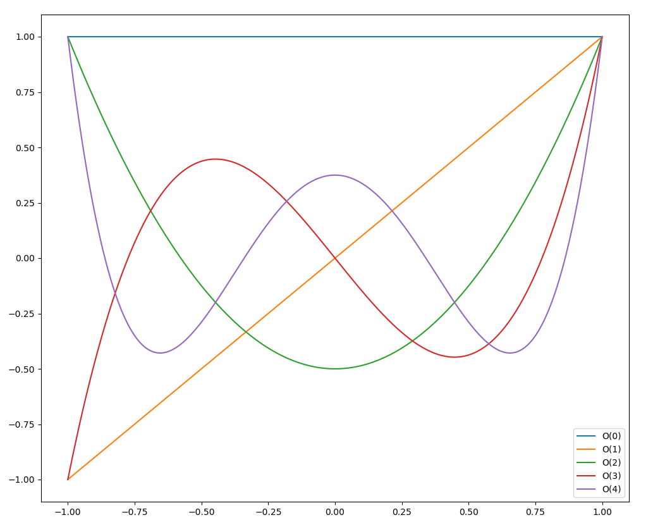
Stochastic Collocation for Generalized Polynomial Chaos
Meat and Potatoes Sampling

Slide 10
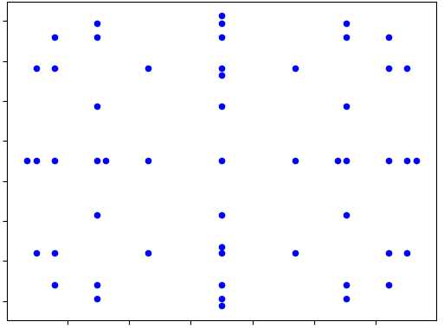
Advanced Sampling: Stochastic Collocation
Generalized Polynomial Chaos
Fit polynomials to model
“Generalized Polynomial Chaos”
Use specially-selected quadrature to sample model
“Sparse Grid Stochastic Collocation”
Uses families of polynomial bases
Performs best when:
Continuous response
Low dimensionality

Slide 11
Running SCgPC Exercise
Code: projectile.py
Activity: Compare statistics
mean, variance
range, time of flight
Vary:
Initial velocity
Initial angle
Try:
Vary polynomial order
In the ROM, not Sampler!
Compare statistics
Advanced:
Change ROM IndexSet
Exercise:
Note:
Outputs are in stats_file.xml
Much more than mean, variance!
Properties of the polynomial ROM
raven/doc/workshop/advancedSampling/
inputs/scgpc.xml

Slide 12
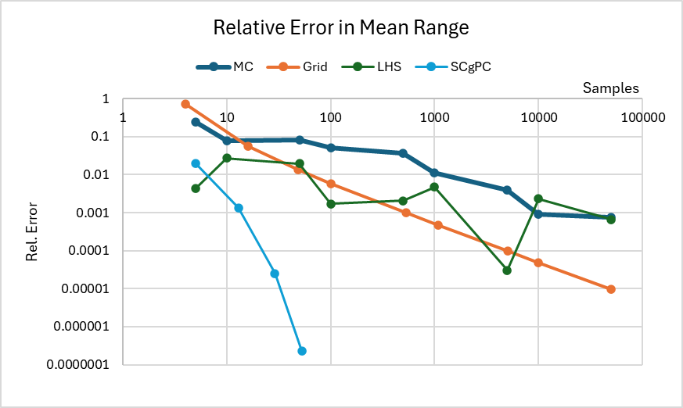
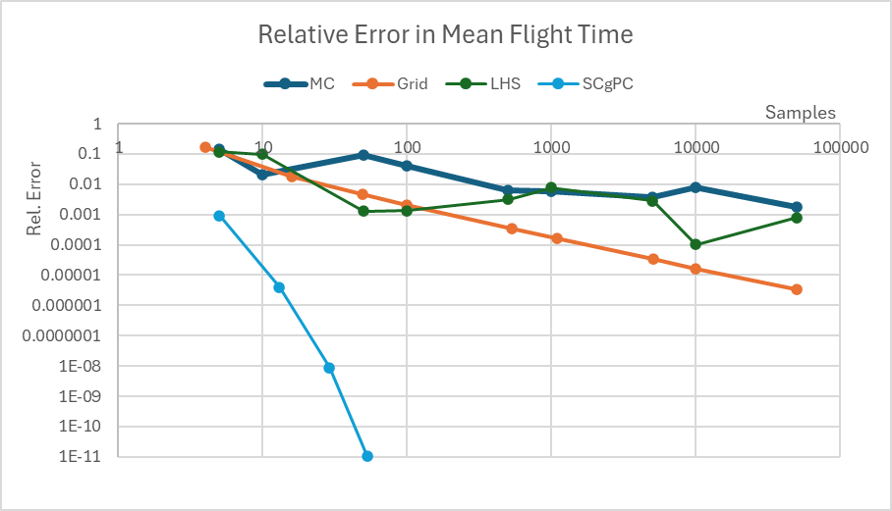
Sampler Convergence Plot (MC, Grid, LHS, SCgPC)

Slide 13
Summary
Many, many sampling strategies exist in RAVEN
Different strategies have different strengths
Explore options for efficient analysis workflows

Slide 14

Time-Evolving Statistics
Meals on Wheels

Slide 15
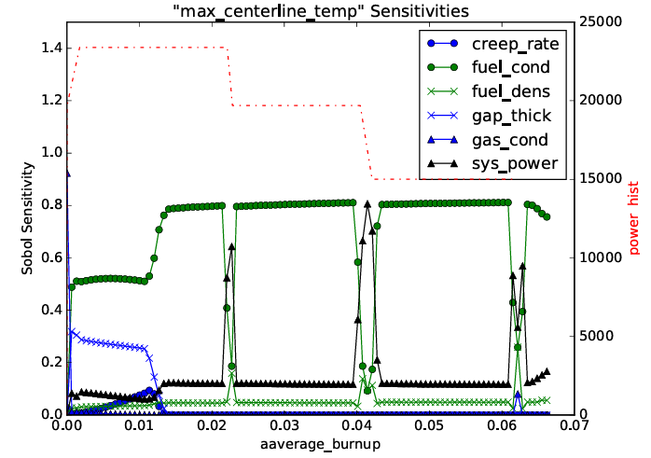
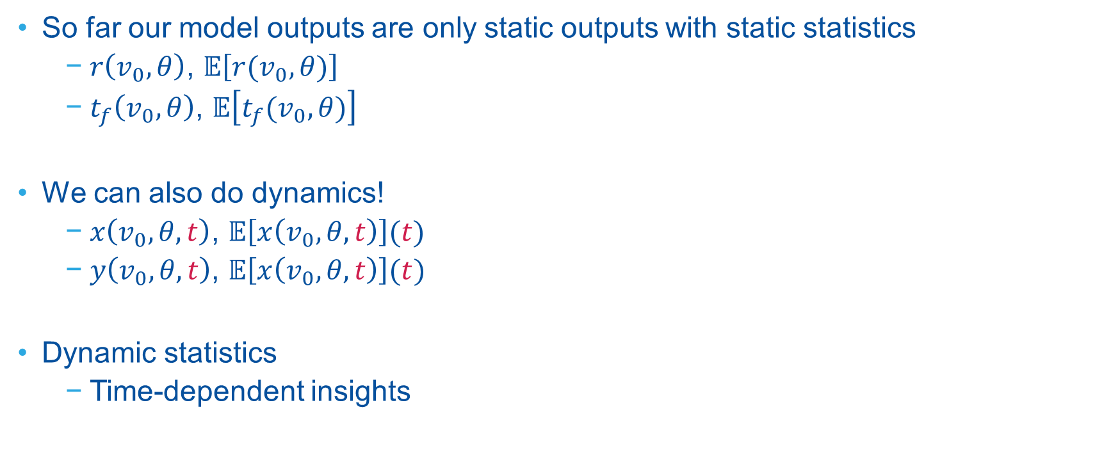
From Static to Dynamic
So far our model outputs are only static outputs with static statistics
$r\left(v_{0},θ\right)$, $𝔼\left[r(v_{0}, θ)\right]$
$t_{f}\left(v_{0},θ\right)$, $𝔼\left[t_{f}(v_{0}, θ)\right]$
We can also do dynamics!
$x\left(v_{0},θ,t\right)$, $𝔼\left[x\left(v_{0}, θ,t\right)\right](t)$
$y\left(v_{0},θ,t\right)$, $𝔼\left[x\left(v_{0}, θ,t\right)\right](t)$
Dynamic statistics
Time-dependent insights

Slide 16
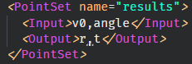
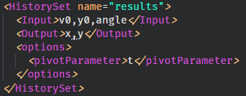
Data Structures in RAVEN
DataObjects
The vehicle for data in RAVEN calculation flows
Store each “realization” in a “row”
In general, consider it as a CSV
Two main subtypes:
PointSet:
Each entry is a single-valued entry (scalar: float, string, etc)
If a vector is provided, it keeps only the last entry
HistorySet:
Each input is a single-valued entry
Outputs all share a single vector index (e.g. “time”)
Index specified through pivotParameter

Slide 17
Data Objects: Visualization
PointSet
Inputs
Outputs
Metadata
Variables
y0 | ang | r | t | ProbWt | PtProb
0.0 | 5.0 | 15.95 | 0.5336 | 0.00028 | 0.0125
0.033 | 7.667 | 24.53 | 0.825 | 0.00056 | 0.0125
0.3 | 55.67 | 85.75 | 5.064 | 0.00056 | 0.0125
1.0 | 85.0 | 16.03 | 6.132 | 0.00028 | 0.0125
Samples, Runs
(Realizations)

Slide 18
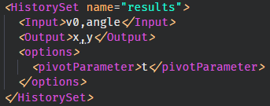
Data Objects: Visualization
HistorySet
Inputs
Pivot
Outputs
Metadata
Variables
v0 | ang | time | x | y | PtProb
0.1 | 5.0 | <vector> | <vector> | <vector> | 0.0125
0.2 | 7.667 | <vector> | <vector> | <vector> | 0.0125
[name].csv
time | x | y
0 | 0 | 0
0.1 | 0.02 | 0.1
0.2 | 0.04 | 0.19
0.3 | 0.06 | 0.27
Samples
(Runs)
[name]_0.csv
[name]_1.csv
…

Slide 19
Running Time Dependent Statistics Exercise
Code: projectile.py
Activity: time-dependent stats
Horizontal position
Vertical position
Vary:
Initial velocity
Initial angle
Try:
Look at time dependent statistics
Do the means make sense?
What about sensitivities?
Advanced:
Limit “angle” to [5, 45] degrees
Exercise:
Note:
Outputs are in stats_file_0.csv
Column 0 is “t”
raven/doc/workshop/advancedSampling/
inputs/dynamic.xml

